Slide 1

Hate Speech Detection on Social Media Using Graph Convolutional Networks
Notes:
Hello Everyone, I am Seema Nagar, from IIIT Guwahati, India. Today I am going to talk about my work on “Hate Speech Detection on Social Media Using Graph Convolutional Networks”.

Slide 2
Background and Motivation
Online social media platforms are increasingly being used for hateful content generation, sometimes inciting real life violence as well.
Hate manifests in multiple types/forms on social media, such as hate with respect to gender, race, religion, ethnicity and color.
Research so far has addressed hate detection mainly from textual features either handcrafted or learned automatically.
It is important to take a holistic view for hateful content detection
It should factor in the evolving language, personalized meaning words/phrases in communities and the larger event in which the hateful content is produced.
We propose to capture important signals such as user language and social context to improve hate detection.
Notes:
Online social media platforms are increasingly being used for hateful content generation, sometimes inciting real life violence as well. Hate can express itself in various forms such as hate with respect to gender, race, religion, ethnicity and color. Traditional hate speech detection is modelled as a classification task based on the features extracted from the text. But these approaches are not reliable as language evolve with time, and there is personalized meaning of words or phrases within a community or with respect to the event the hateful content is produced. That’s why, now the research community is moving towards having additional context such as audience, user features, language features and social network features to encode the external, use language and the social context. The holistic view is important to have a reliable and accurate hate speech detection.

Slide 3
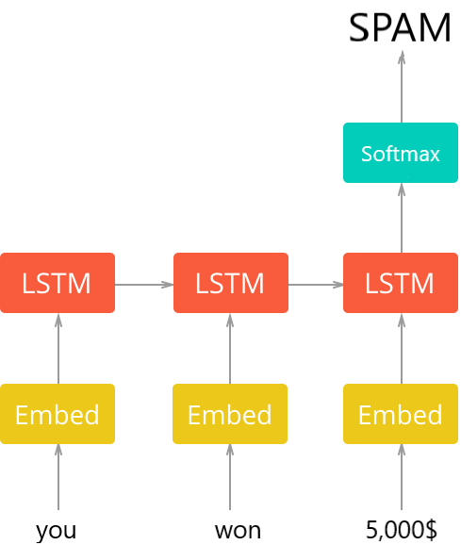
Generic Approach of Detecting Hate Speech
The example shows an LSTM model for explanation purpose.
Transformer based architectures are also used for classification task
Output
Notes:
The is generic architecture for hate speech classification task based on deep learning approach, where a piece of text or a comment or a tweet is first tokenized and then each token is encoded using word embedding techniques, followed by a recurrent neural network such long short-term memory called LSTM and finally the output is passed to softmax to predict the classification labels. Sometimes instead of LSTM, transformers-based architectures are also used for classification task.

Slide 4
Proposed Multimodal Architecture
The proposed model architecture uses not just text features but also learns the aggregated node representations using a GCN (graph convolutional network) feature extractor.
The text features and the network features are concatenated and passed through a FFNN with a softmax layer to generate the output class.
Notes:
We propose a multi-modal architecture, which uses multiple input modalities to detect hateful content. We use a user’s unified features who have produced the content derived in addition of the text features of a piece of content. The user’s unified features are inferred from user language, user profile and the social network. We represent a author as a node in a social network graph and an aggregated author representation is learnt using graph convolutional based feature extractor. The aggregated representation capture a user’s language feature, user profile as well as social network feature.

Slide 5
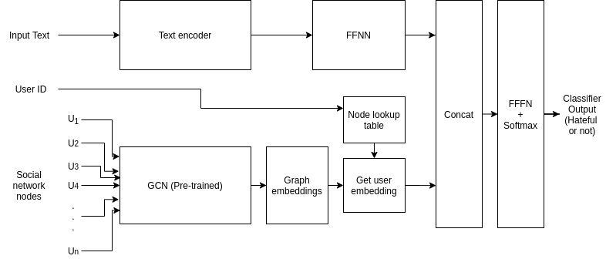
Proposed multimodal architecture
Notes:
The figure illustrates our proposed architecture. We have two components, text encoder and a GCN based unified feature encoder. Both the text encoder and the GCN encoder are pre-trained. User unified feature, represents a user’s social network, user profile as well as language features. The text encoding is passed through a fully forward neural network (FFNN). The output of FFNN and the user’s unified features are concatenated to get a single representation. The concatenated features are passed through a fully forward neural network, followed by a soft max for binary classification.

Slide 6
Capturing Unified User Features from social network, profile and language
Jointly learn a user’s social network, user profile and language features using variational graph autoencoders (VGAE)(Kipf and Welling, 2016).
Graph Convolutional Networks (GCN) have shown promising performance in link prediction and node classification tasks (Jeong et al., 2019).
Using VGAE to jointly encode a user’s social network, user profile and language features, we aim to capture the contextual, social and personalized nature of hate.
This is the first approach to utilize VGAE to jointly learn a user’s social network and language features.
Notes:
We capture a user’s features as joint representation of social network and user’s language and profile features. We We jointly learn a user’s social network and language, profile features using variational graph auto encoders (VGAE)(Kipf and Welling, 2016). Graph Convolutional Networks (GCN) have shown promising performance in link prediction and node classification tasks (Jeong et al., 2019). Using VGAE to jointly encode a user’s social network, user profile and language features and further utilizing textual features of the content itself, we aim to capture the contextual, social and the personalized nature of hate.
To the best of our knowledge we are the first to utilize VGAE to jointly learn a user’s social network and language features.

Slide 7
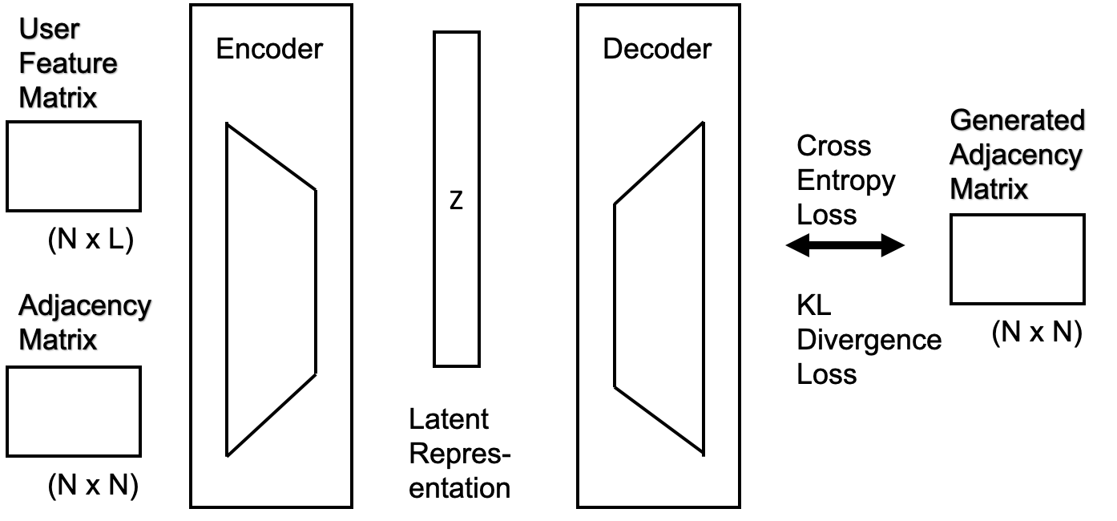
Variational Graph Auto Encoder
The encoder for a VGAE is written as qφ(Z|X, A)
Notes:
The figure depicts a typical variation graph auto-encoder. It has two components, encoder and decoder. Encoder takes two input, graph in the form of adjacency matrix and the user features derived from user language features and profile information and transforms the input to a a low dimension latent representation Z. The latent representation Z is fed to a decoder network, which constructs the adjacency matrix. The reconstruction error loss in the form of cross entropy and KL divergence loss is backpropagated to the learn the weights in the network.

Slide 8
Generating the user features for the VGAE
User features are generated from the two types of text a user have produced,
a) posts made by the user and
b) profile information of the user on social media platform.
Notes:
VGAE takes two input, the use features and the graph adjacency matrix, Use features are generated from the two types of text a user have produced,
a) posts made by the user and b) profile information of the user on social media platform. The user features help us to capture the language features pertraining to a particular user as well as the profile of a user.

Slide 9
Generating the user features for the VGAE
The mechanism to generate user features is explained below:
1. For each user i, the two types of texts are concatenated to form a document di
2. Create a corpus D of documents from all the users, where D = d1, d2, ..., dn
3. For each document, text is tokenized and tf-idf score is computed for each token
4. Using the tf-idf scores for each document, a feature vector vi is generated for each user i
Notes:
This is how we generate use features: Step 1: For each user i, the two types of texts, user posts and the profile information are concatenated to form a document di
Step 2. Create a corpus D of documents from all the users, where D = d1, d2, ..., dn
Step 3. For each document, text is tokenized and tf-idf score is computed for each token
Step 4. Using the tf-idf scores for each document, a feature vector vi is generated for each user i

Slide 10
Advantage of this model architecture
The proposed model makes use of multi-modal data present on social media platforms. In particular, it uses two types of modalities, text and social network.
Construct two types of features for a post
textual features from the text content of the post and
unified user features.
The unified use features capture three types of information about a user
social network,
language use and
meta-data.
The unified user features are encoded into a fixed size vector using graph convolutional networks.
Notes:
Our proposed model makes use of multi-modal data present on social media platforms. In particular, we use two types of modalities, text and social network.
We construct two types of features for a post
textual features from the text content of the post and
unified user features.
The unified use features captures three types of information about a user
social network,
language use and
meta-data.
The unified user features are encoded into a fixed size vector using graph convolutional networks.

Slide 11
DataSet
We use two publicly available Founta Dataset and Ribeiro Dataset to conduct the experiments.
1) abusive and hateful data (Founta et al., 2019) and
2) hateful users data (Ribeiro et al., 2017).
Notes:
We experiment with two datasets, the first one is abusive and hateful data from Founta et al and the second one is hateful users data from Ribeiro et al.

Slide 12
Dataset (Cont’d)
Founta dataset is widely used to benchmark hate speech detection
This dataset contains four types of labels which are abusive, hateful, spam and normal.
We use twitter API2 to fetch tweet text, user profile, a user’s previous tweets and follower followee network.
Ribeiro contains 200 most recent tweets of 100; 386 users, totalling to roughly 19M tweets.
Retweet induced graph of the users, as well as 4; 972 users, out of which 544 users are labelled as hateful and the rest as normal
Notes:
Founta dataset is widely used to benchmark hate speech detection. This dataset contains four types of labels which are abusive, hateful, spam and normal. We use twitter API2 to fetch tweet text, user profile, a user’s previous tweets and follower followee network.
Ribeiro contains 200 most recent tweets of 100; 386 users, totalling to roughly 19M tweets. Retweet induced graph of the users, as well as 4; 972 users, out of which 544 users are labelled as hateful and the rest as normal

Slide 13
Datasets
Dataset | Count of Tweets | Count of Nodes | Count of Edges | % of Hateful Tweets
Founta | 43,405 | 47,054 | 8,11,471 | 27.5
Ribeiro | 30,720 | 18,642 | 7,71,401 | 39.5
Notes:
The table shows the statistic of the two datasets. Both the datasets are fairly large and contains enough hateful tweests to demonstrate the ffectiveness of our proposed approach.

Slide 14
Experiments Overview
Compare the results achieved from this approach with the two baselines, one of the baseline covering state-of-the-art taking into account the network features. The purpose of the experiments is the following:
• Compare with the baselines and investigate the effect of using GCN features in the classification of hateful content.
• Investigate the correlation of network features with the performance of the proposed framework.
• Investigate the effect of textual length on the performance of the proposed framework.
Notes:
We compare with two baselines to empirically establish efficacy of our approach. We also investigate the significant of using GCN features in the classification of hateful content. We also investigate the correlation of network features with accuracy and also delve into the effect of textual length in the performace.

Slide 15
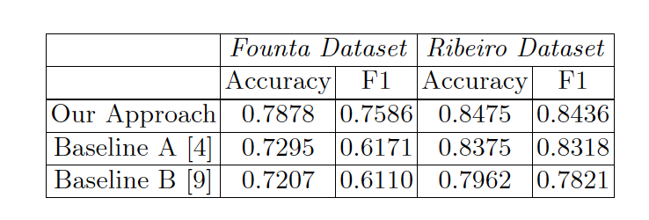
Results
Notes:
The baseline A captures state of the art, where manually defined network features such as centrality metrics are used along with the text features. The baseline captures state of the art for using text only features to detect hate using deep learning approaches. We see that we clearly outperform both the approaches.

Slide 16
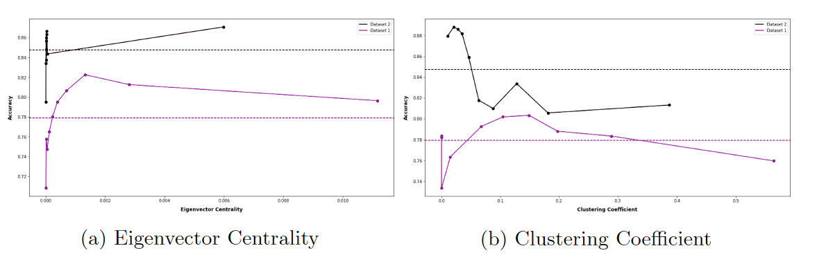
Correlation of Graph Features with Accuracy

Slide 17
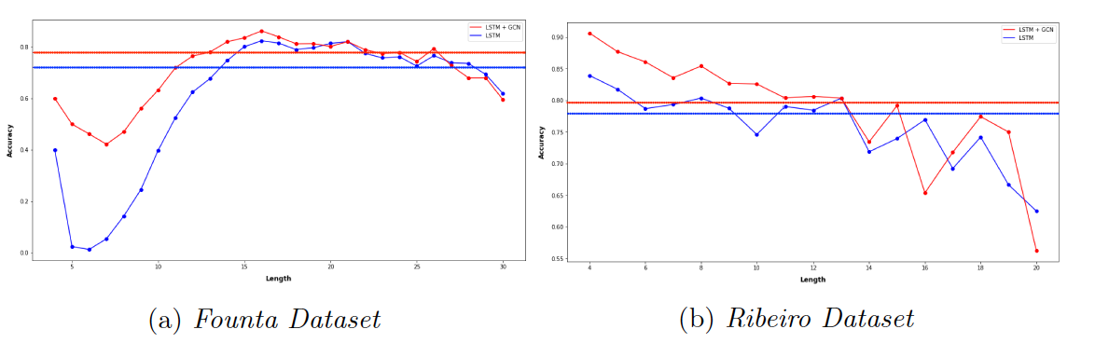
Effect of Tweets Length on Classification Accuracy

Slide 18
Error Analysis
We investigate the errors committed by our system. We manually looked at the predicted labels of a few 100 misclassified tweets from both the datasets.
We notice a few interesting following patterns: a) Tweets not having enough context around hateful/bad words, b) Tweets having wrong original annotation by humans, c) Tweets needing external context to get the semantic meaning and d) Tweets where hate is present as sarcasm
Notes:
We investigate the errors committed by our system. We manually looked at the predicted labels of a few 100 misclassified tweets from both the datasets.
We notice a few interesting following patterns: a) Tweets not having enough context around hateful/bad words, b) Tweets having wrong original annotation by humans, c) Tweets needing external context to get the semantic meaning and d) Tweets where hate is present as sarcasm

